Slide 1
50 kW Integrated Fault toerant Permanent Magnet Machine and Motor Drive

Slide 2
Overwiev
Machine and Power electronics losses and PSFB (Phase Shifted Full Bridge) concept
Termal Design

Slide 3
Benefits of system integration (adding power electronic to machine)
-Power density can be increased.
-total weight and volume is intended to decrease. (at Aerospace and electric car etc. İt is important)

Slide 4
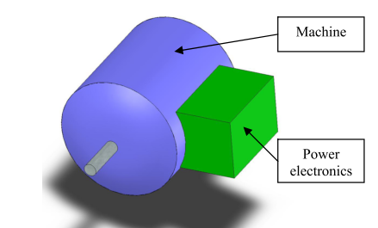

Slide 5
Problem
If loss density remains same, there will be heating

Slide 6
The objective of this paper is to investigate the feasibility of integrating a fault tolerant system consisting of an electrical machine and power electronics into a single, more power dense structure.

Slide 7
Fault Tolerace and System Integration
Reduncancy
Partitioning

Slide 8
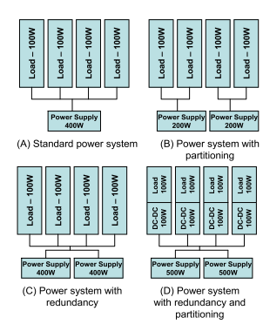

Slide 9
Permanent Magnet is preferred for higher power density but switched reluctance machine also preferred for fault tolerant applications.

Slide 10
Phase number should be adjusted by optimizing loss and healty phases.

Slide 11
Machine Design and Construction
Isolated and concentrated structure
Balance

Slide 12
In order to prevent short circuit phases should be isolated magnetically and electrically from neighbours.
If there is a fault condition, not one, two phase should be removed to satisfy balance.

Slide 13
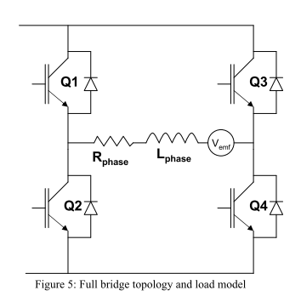
Power Electronics

Slide 14
PSFB (Phase Shifted Full Bridge):
There is low frequency an it limits semiconductor losses to induction loss only.
• If fault condition occurs in the DC bus capacitors, bus capacitors will be disonnected via the fuse.

Slide 15
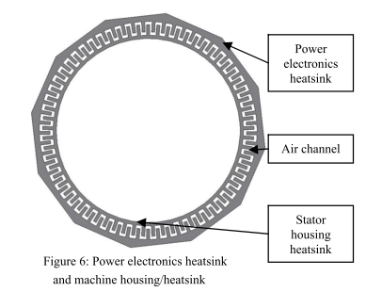
Thermal Management and Packaging Concept

Slide 16
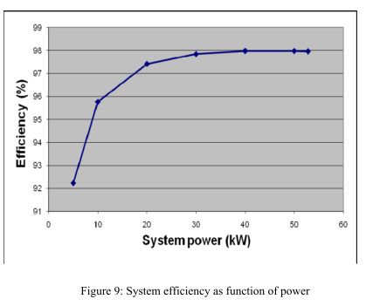

Slide 17
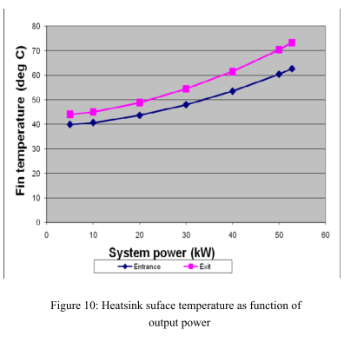

Slide 18
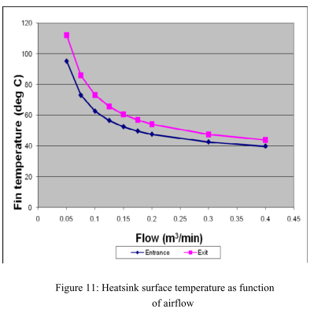

Slide 19
SUMMARY
Intention:
Significant decrease at total volume while keeping total output the same.

Slide 20
Swıtched Reluctance Machines
Copper fill fator is high
However, SRM needs two terminl conections per phase

Slide 21
Design of Intagrted and Distributed Inverter
Inverters consist of one asymmetrical half bridge per phase, two switches and two diodes
There are redundancy (if there is failure, remaining phases can continue the operation.)

Slide 22
Loss is low and cooling performance is great
However, it is expensive comparing to standard inverter.

Slide 23
Communication
Phase connected paralll and communication is satisfied via DSP.

